Slide 1

WAY TO ENTERPRISE
Java

Slide 2
Agenda
Debug
Handling Exception
Assignments
Copyright © VTI Academy All Rights Reserved

Slide 3
Debug
Breakpoint
Debug mode
Expression
Variable

Slide 4
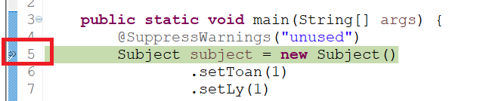
Breakpoint

Slide 5
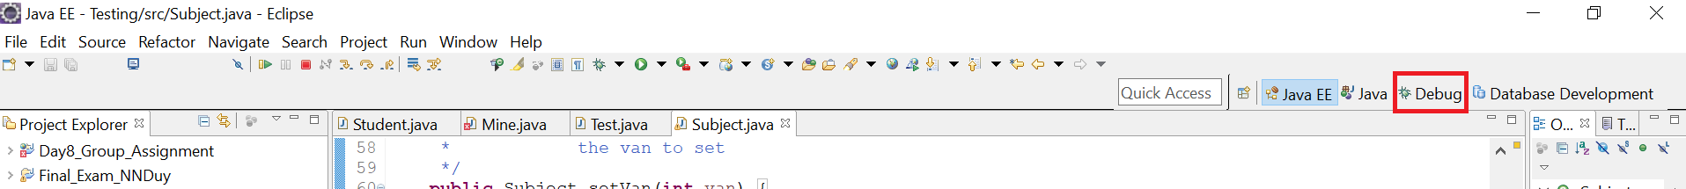
Debug Mode
Step into (F5)
Step return (F7)
Step over (F6)
Resume (F8)
Stop (Ctrl + F2)
Debug Mode (Alt + Shift + D + J)

Slide 6
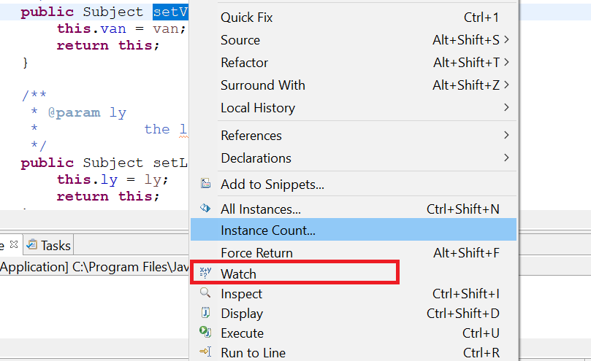
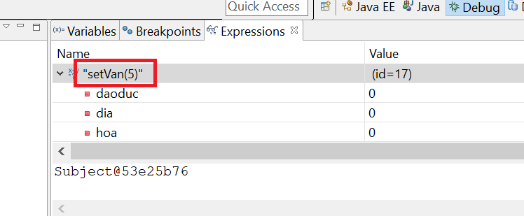
Expression

Slide 7
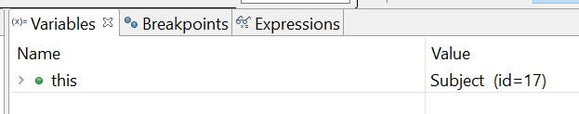
Variable

Slide 8
Handling Exception
Catching
  Compile error
  Logical error
Common Exception
  ArrayIndexOutOfBoundException
  ArithmeticException
  NullPointerException

Slide 9
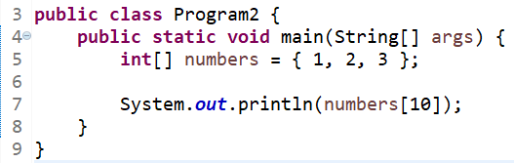
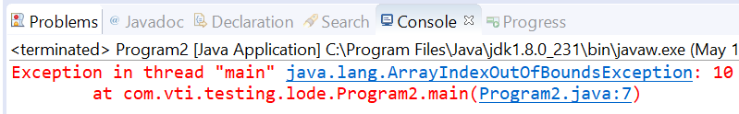
ArrayIndexOutOfBoundException

Slide 10
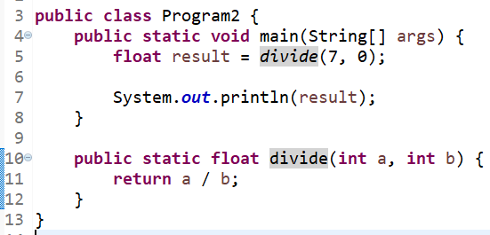
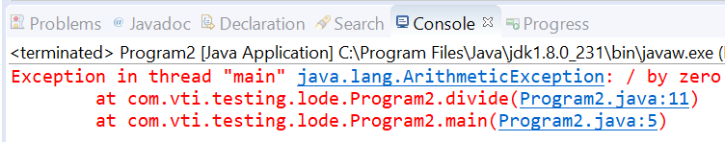
ArithmeticException

Slide 11
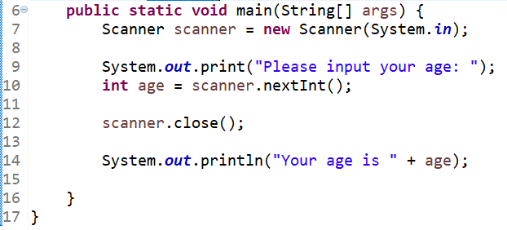
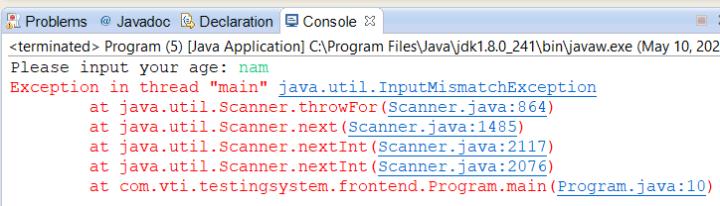
InputMismatchException
Notes:
Lỗi convert dữ liệu, kiểu int nhưng lại nhập vào 1 string

Slide 12
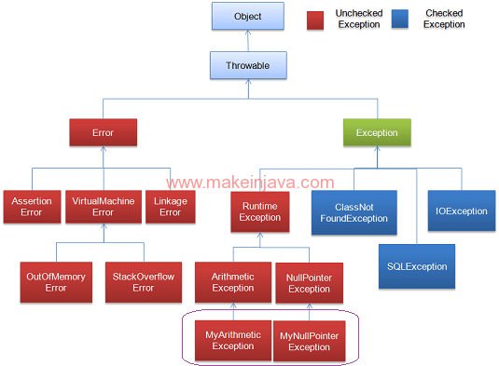
Exception

Slide 13
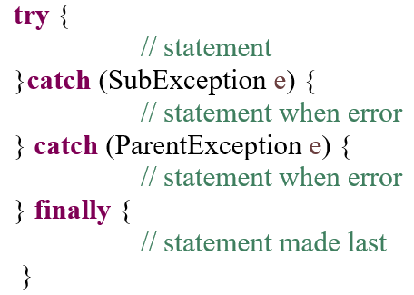
Syntax

Slide 14
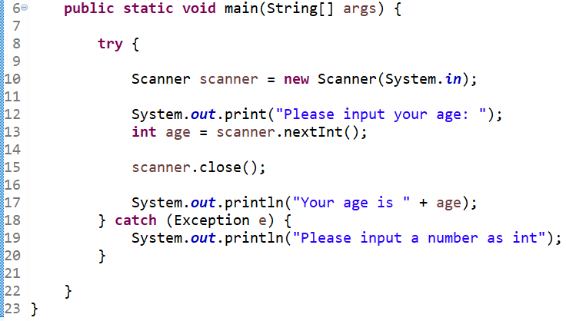
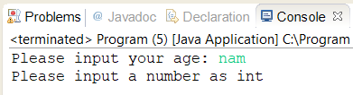
Example 1

Slide 15
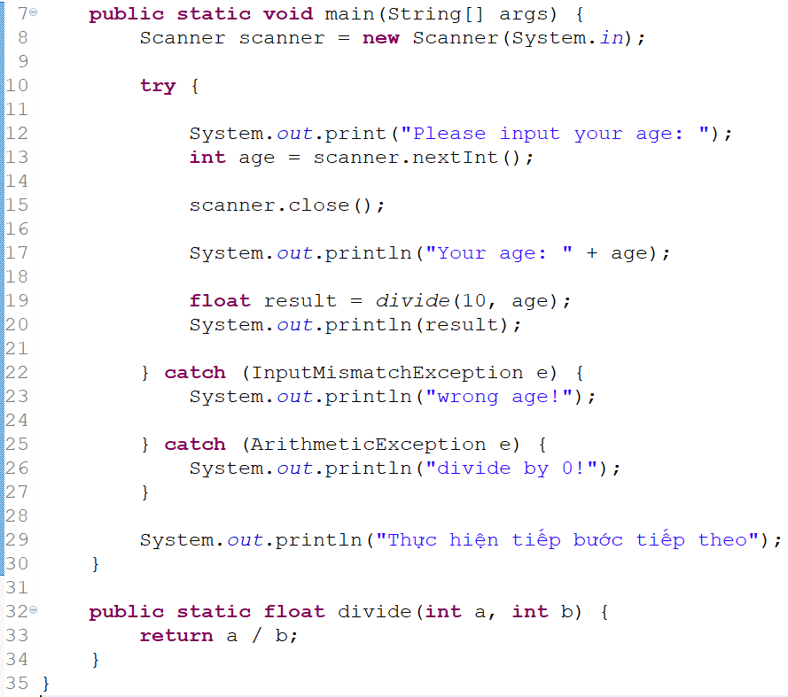
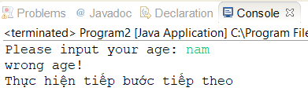
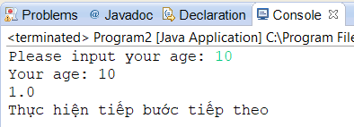
Example 2

Slide 16
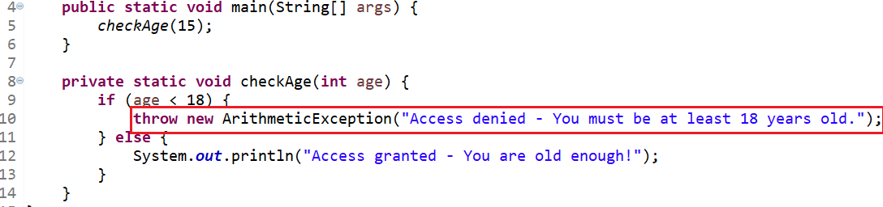
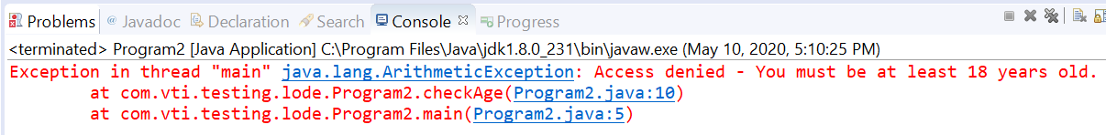
Throw & Throws

Slide 17
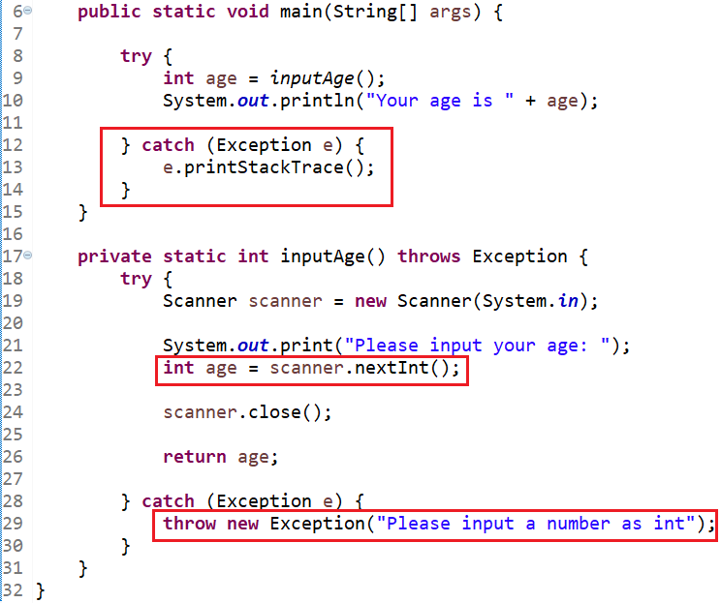
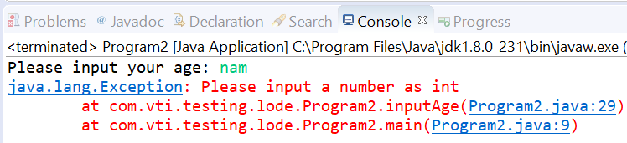
Example 1

Slide 18
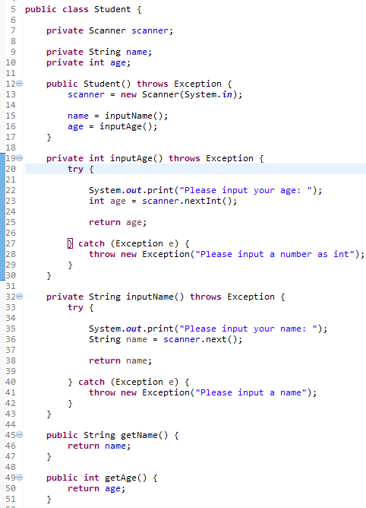
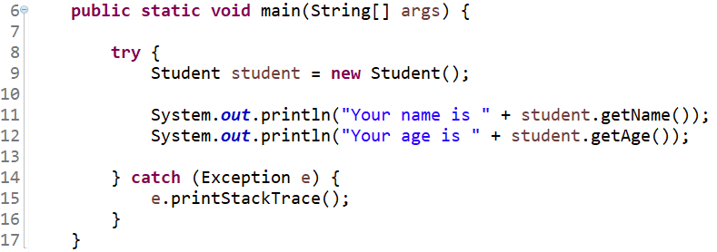
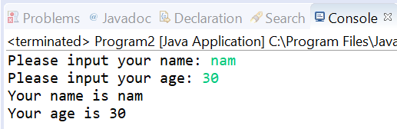
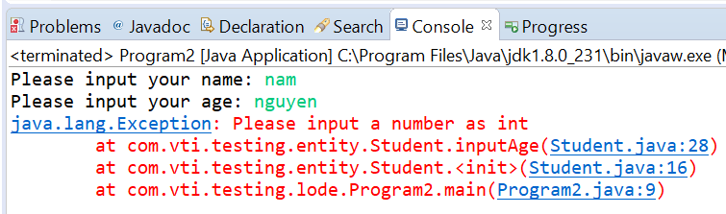
Example 2

Slide 19
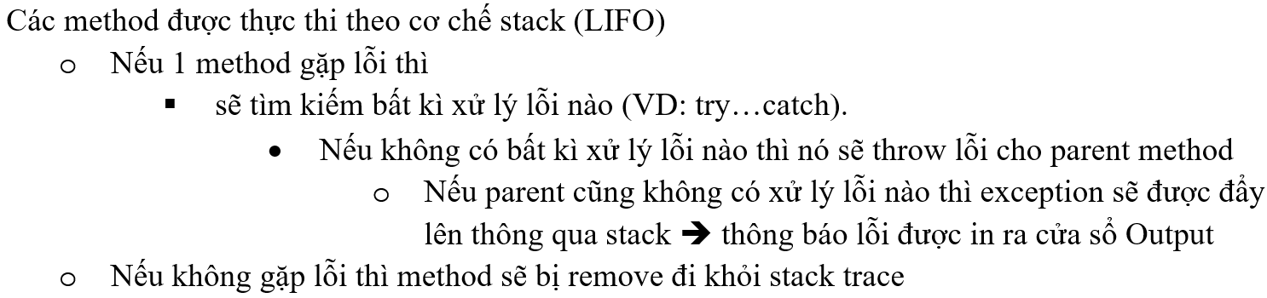
Stack Trace

Slide 20
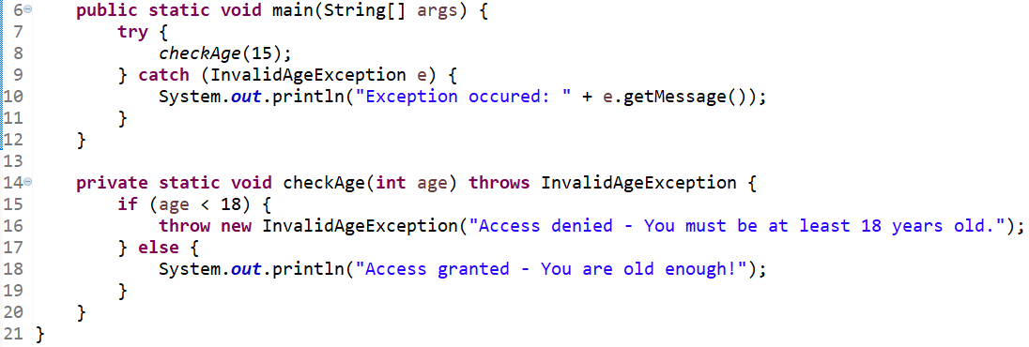
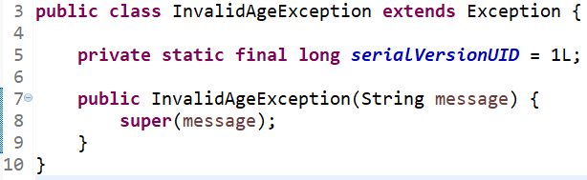
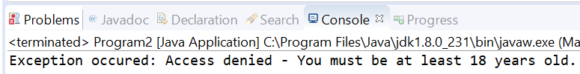
Custom Exception

Slide 21
Q & A
Copyright © VTI Academy All Rights Reserved

